Slide 1
Physical holdings retention in Alma
Yoel Kortick
Yoel.Kortick@clarivate.com

Slide 2
Agenda
  Introduction
  Physical Holdings Records Retention – option 1
  Testing the Physical Holdings Records Retention – option 1
  Physical Holdings Records Retention – option 2
  Testing the Physical Holdings Records Retention – option 2
  Globally updating records for Physical Holdings Records Retention
  Physical holdings retention and the PO Line

Slide 3
Introduction

Slide 4
Introduction
Note that this presentation, as the title suggests, relates specifically to the retention of physical holdings records.
A mechanism already exists for the retention of bibliographic records and physical items. For details regarding that mechanism see
  Bibliographic record and physical items retention in Alma (PowerPoint)
  Bibliographic record and physical items retention in Alma (YouTube video)
  Committed to Retain for Physical Items (On Line Help)
See also the On Line Help for Physical Holdings Retention:
  Physical Holdings Records Retention (On Line Help)

Slide 5
Introduction
"Physical Holdings Records Retention" allows libraries to prevent the deletion of specific holdings records.
This feature is of particular importance for libraries with collaborative collections whereby the library wishes to protect specific inventory from deletion. This is often referred to as "Collaborative Collections" and frequently (though definitely not "always") has particular significance for resource sharing.
This is also important for libraries desiring to make sure that important records such as rare materials, faculty publications, donations and other important physical holdings do not accidentally get removed from the catalog.

Slide 6
Introduction
A primary use case for "Physical Holdings Records Retention" is for journals in which the items are not entered individually. This is often the case in institutions where the journal issues are not loaned, and thus there is no need to enter each issue into Alma as a physical item. Instead, an 86X Textual Holdings Statement suffices.
If there is a Holdings record which has items under the holdings, then the items can be designated as "Committed to Retain" and this will prevent not only the items from being deleted but also the Holdings Record to which they belong. See Bibliographic record and physical items retention in Alma.pptx
Conversely, take note that if a Holdings Record is committed to retain and the Holdings record does have items, then the items can be deleted. Thus the “Holdings record Committed to Retain” does not affect the ability to delete the items of the Holdings record.

Slide 7
Physical Holdings Records Retention - option 1

Slide 8
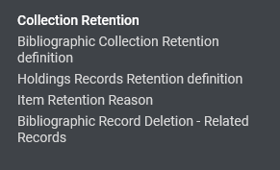
Physical Holdings Records Retention - option 1
To use "Physical Holdings Records Retention" the table " Holdings Records Retention Definition" needs to be defined.
This table can be accessed at "Configuration > Resources > Collection Retention > Holdings Records Retention Definition"

Slide 9
Physical Holdings Records Retention - option 1
In the table " Holdings Records Retention Definition " the institution can specify conditions for record retention.
The institution can use the table in either of the following ways:
  Add a field and subfield to the table in order for the record to be protected from deletion if the field and subfield contains any value.
  Add a field and subfield to the table and also specify a specific value for the subfield, and only records which contain this value in the field and subfield will be protected from deletion.
We will now show option 1

Slide 10
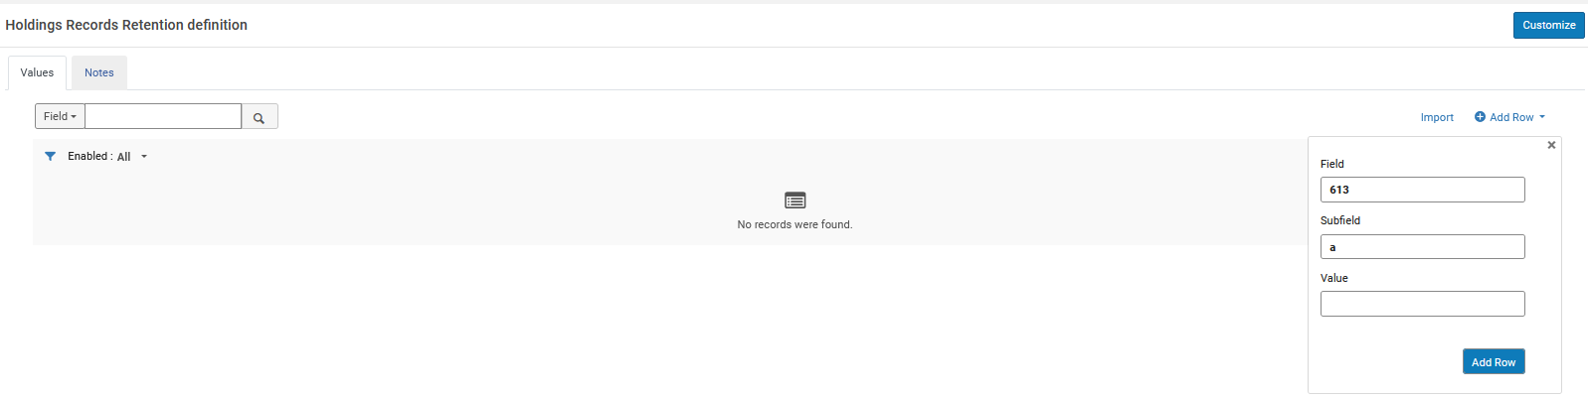
Physical Holdings Records Retention - option 1
We will now add a field without a specific subfield value.
In this case we are adding a local field "613".
No specific value.
Can be any value.

Slide 11
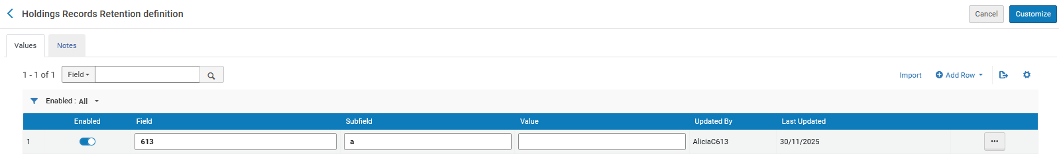
Physical Holdings Records Retention - option 1
This means: If the record has a 613 subfield a with any value, then it cannot be deleted.
This is blank, so therefore any value in the subfield will prevent deletion.

Slide 12
Testing the Physical Holdings Records Retention – option 1

Slide 13
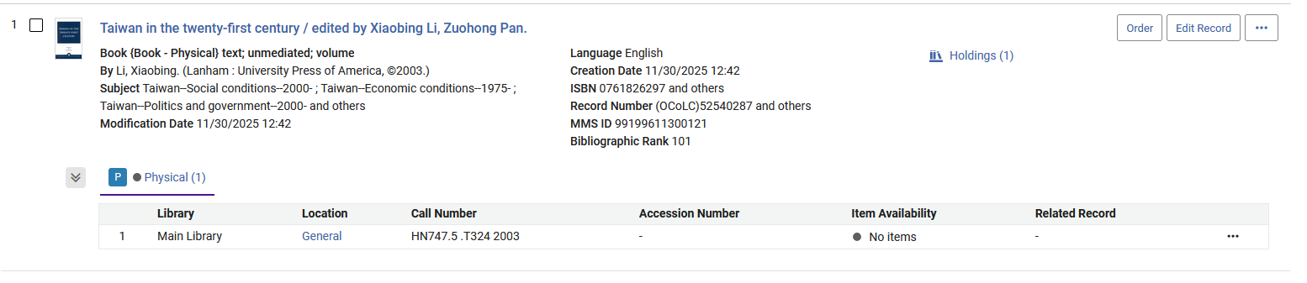
Testing the Physical Holdings Records Retention – option 1
Title "Taiwan in the twenty-first century / edited by Xiaobing Li, Zuohong Pan." (MMSID 99199611300121) has one Holdings Record.

Slide 14
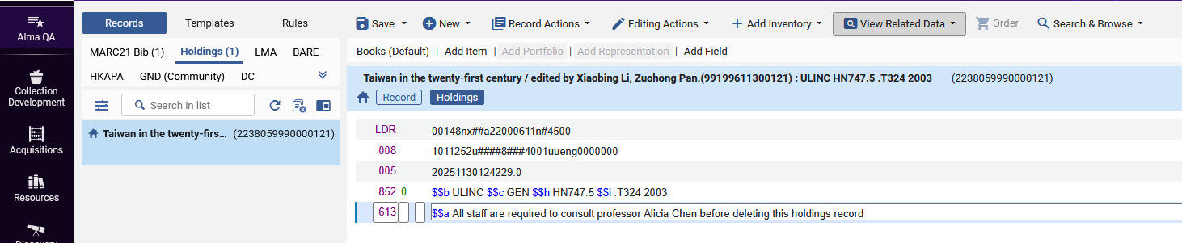
Testing the Physical Holdings Records Retention – option 1
We are now adding a 613 local field to the Holdings Record

Slide 15
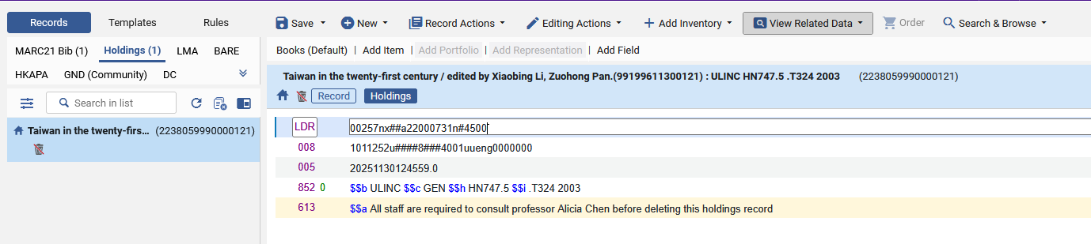
Testing the Physical Holdings Records Retention – option 1
After saving the record with the 613 local field to the Holdings Record we have an icon signifying that this Holdings Record has been committed to retain.
Here is the "Committed to Retain" icon in the metadata editor.

Slide 16
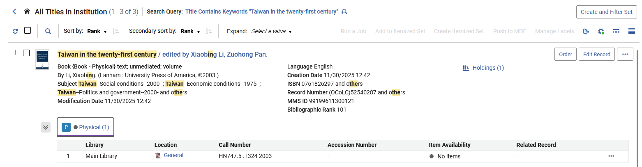
Testing the Physical Holdings Records Retention – option 1
Here is the "Committed to Retain" icon in the "All Titles" repository search.

Slide 17
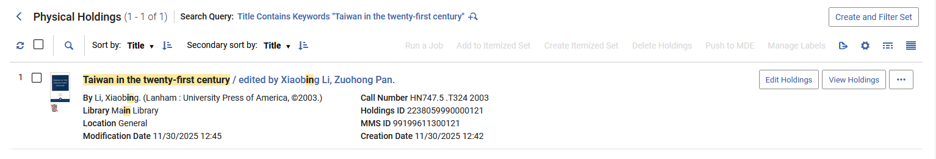
Testing the Physical Holdings Records Retention – option 1
Here is the "Committed to Retain" icon in the "Physical Holdings" repository search.

Slide 18
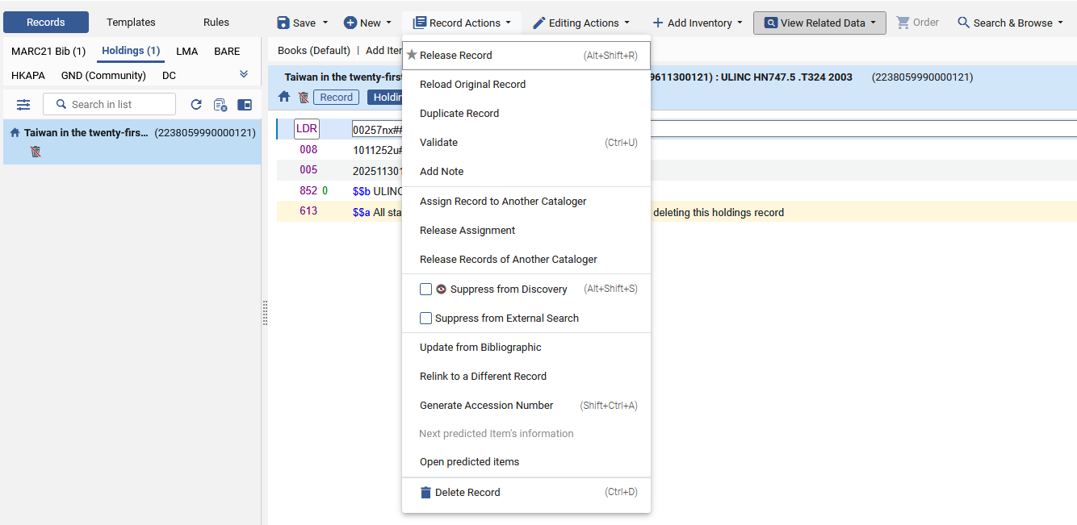
Testing the Physical Holdings Records Retention – option 1
We will now try to delete the Holdings Record which has been Committed to Retain

Slide 19
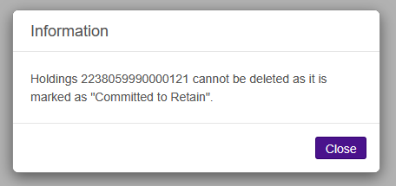
Testing the Physical Holdings Records Retention – option 1
We cannot delete the record and receive an explanatory error message.

Slide 20
Physical Holdings Records Retention - option 2

Slide 21
Physical Holdings Records Retention - option 2
To use "Physical Holdings Records Retention" the table " Holdings Records Retention Definition" needs to be defined.
This table can be accessed at "Configuration > Resources > Collection Retention > Holdings Records Retention Definition"

Slide 22
Physical Holdings Records Retention - option 2
In the table " Holdings Records Retention Definition " the institution can specify conditions for record retention.
The institution can use the table in either of the following ways:
  Add a field and subfield to the table in order for the record to be protected from deletion if the field and subfield contains any value.
  Add a field and subfield to the table and also specify a specific value for the subfield, and only records which contain this value in the field and subfield will be protected from deletion.
We will now show option 2

Slide 23
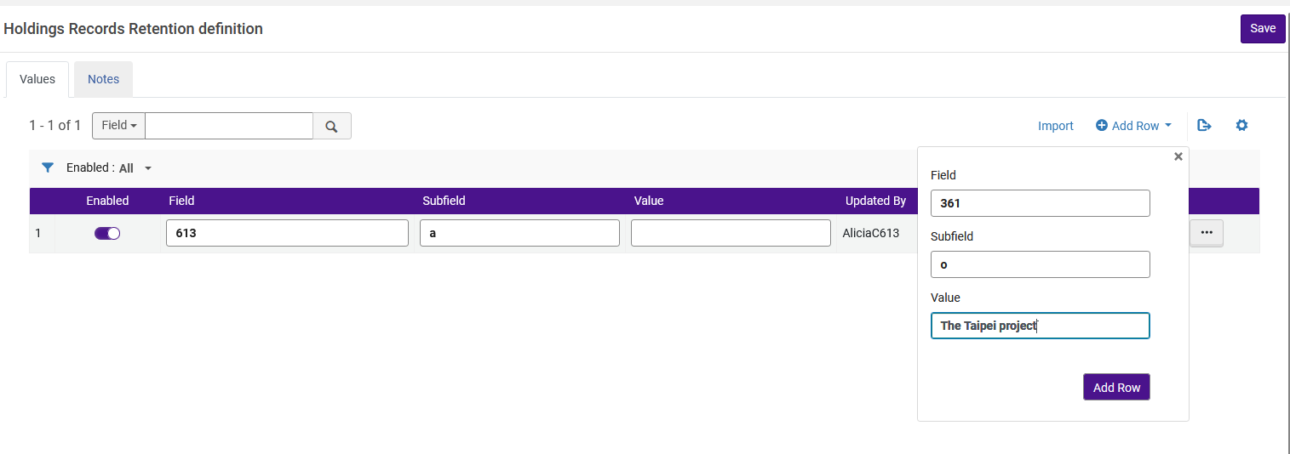
Physical Holdings Records Retention - option 2
We will now add a field with a specific subfield value
A specific value.
It must be this value.

Slide 24
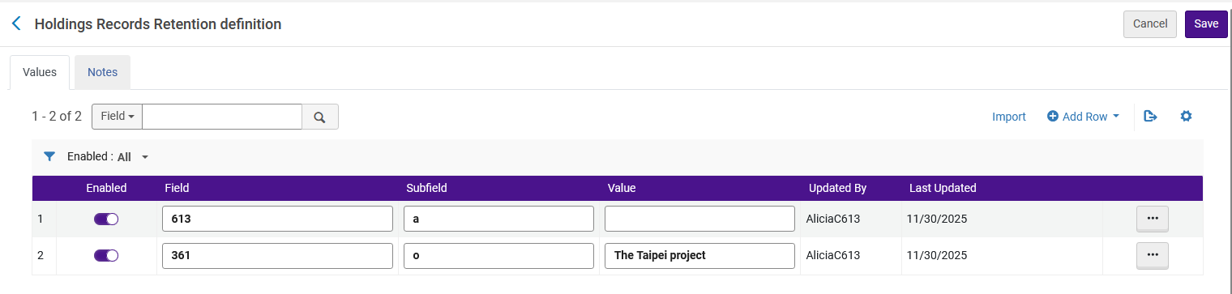
Physical Holdings Records Retention - option 2
This means: If the record has a 361 subfield o with value "The Taipei project" then it cannot be deleted.
This value is not blank, so therefore the 361 field must have this specific value in order to prevent deletion.

Slide 25
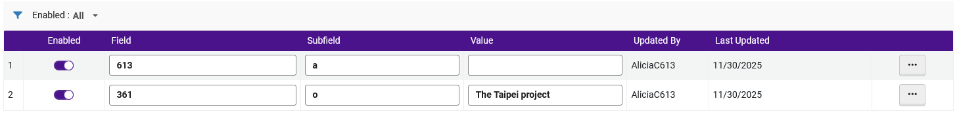
Physical Holdings Records Retention - option 2
Summary: table "Holdings Records Retention definition" contains these two lines:
Any value in 613 subfield a (the mere presence of a 613 subfield a) will prevent the holdings record from being deleted.
The presence of a 361 subfield o with value "The Taipei project" will prevent the holdings record from being deleted.
The presence of a 361 subfield o with any value other than "The Taipei project" will not prevent the holdings record from being deleted.

Slide 26
Testing the Physical Holdings Records Retention – option 2

Slide 27
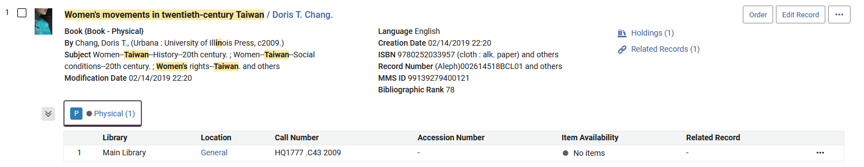
Testing the Physical Holdings Records Retention – option 1
Title "Women's movements in twentieth-century Taiwan / Doris T. Chang." (MMSID 99199611200121) has one Holdings Record.

Slide 28
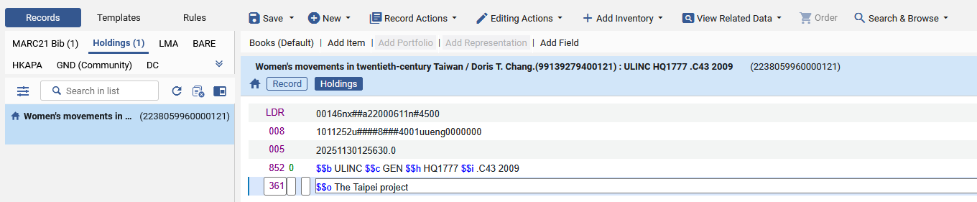
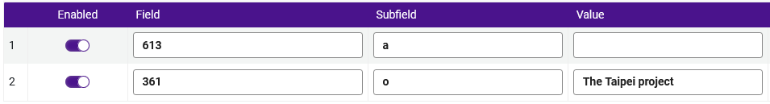
Testing the Physical Holdings Records Retention – option 1
We are now adding a 361 field to the Holdings Record and we are including the exact field and subfield which we defined in table "Holdings Records Retention definition".

Slide 29
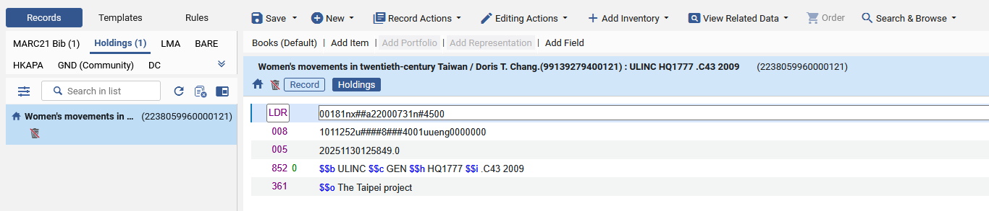
Testing the Physical Holdings Records Retention – option 1
After saving the record with the 361 field including the exact field and subfield which we defined in table "Holdings Records Retention definition" in the Holdings Record we have an icon signifying that this Holdings Record has been committed to retain.
Here is the "Committed to Retain" icon in the metadata editor.

Slide 30
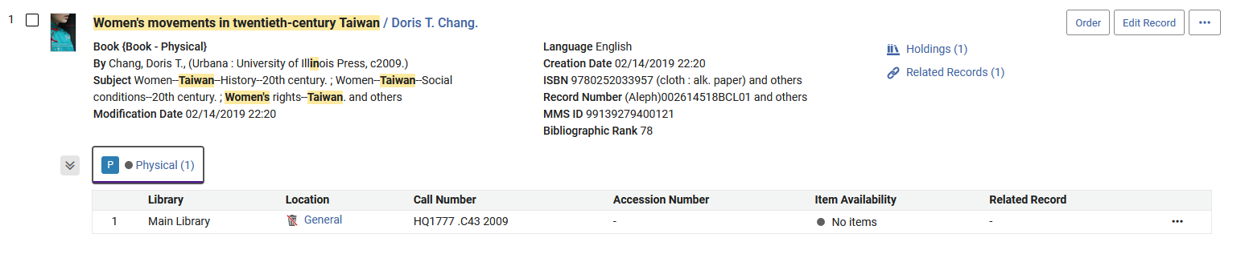
Testing the Physical Holdings Records Retention – option 1
Here is the "Committed to Retain" icon in the "All Titles" repository search.

Slide 31
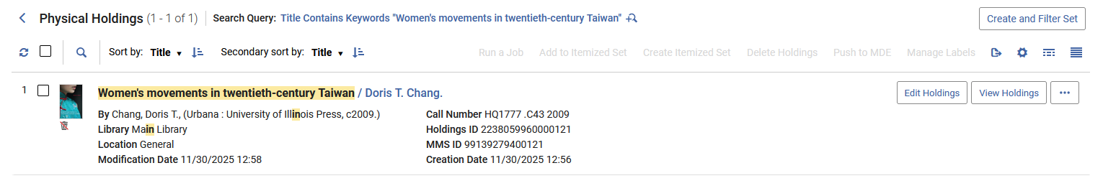
Testing the Physical Holdings Records Retention – option 1
Here is the "Committed to Retain" icon in the "Physical Holdings" repository search.

Slide 32
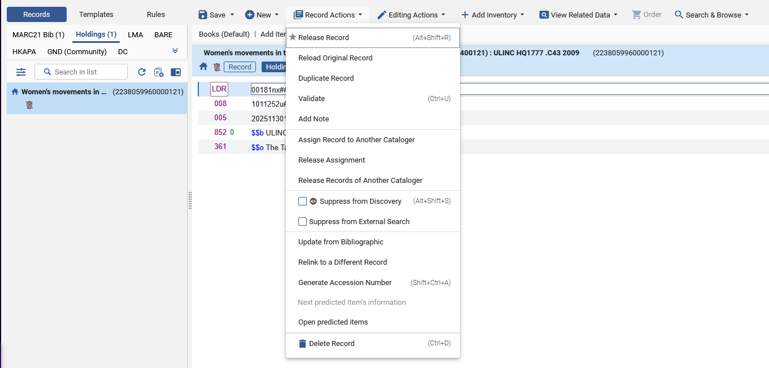
Testing the Physical Holdings Records Retention – option 1
We will now try to delete the Holdings Record which has been Committed to Retain

Slide 33
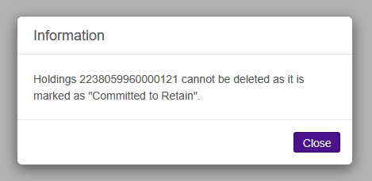
Testing the Physical Holdings Records Retention – option 1
We cannot delete the record and receive an explanatory error message.

Slide 34
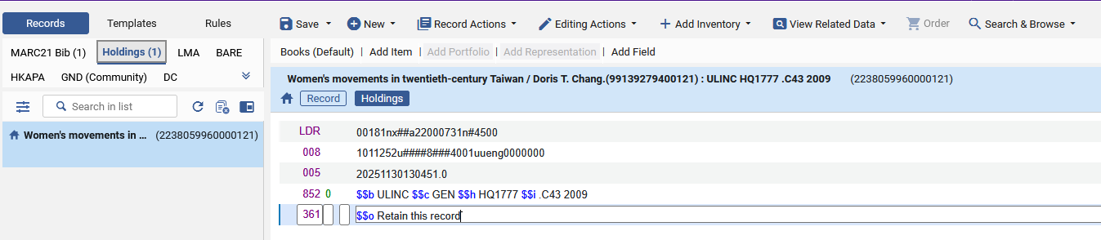
Testing the Physical Holdings Records Retention – option 1
Note that if we have a value in the 361 subfield o which is not in the table "Holdings Records Retention definition" then the holdings record will not be marked as "Committed to Retain"
This is not the value from table "Holdings Records Retention definition"

Slide 35
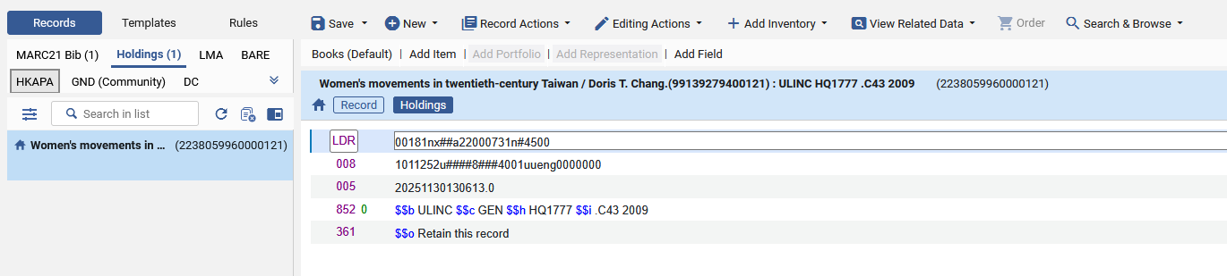
Testing the Physical Holdings Records Retention – option 1
Now the holdings record is not marked as "Committed to Retain".
This is because even though we have a 361 field with subfield o, the text in the subfield o is not the same as the text specified in table "Holdings Records Retention definition".
No "Committed to Retain" icon
This is not the value from table "Holdings Records Retention definition"

Slide 36
Globally updating records for Physical Holdings Records Retention

Slide 37
Globally updating records for Physical Holdings Records Retention
The XSL normalization rule on the next slide will
Work in a MARC 21 holdings record
Add datafield 361 with subfield o with text "The Taipei project" if there is not already a datafield 361 with subfield o with text "The Taipei project"

Slide 38
Globally updating records for Physical Holdings Records Retention
<?xml version="1.0" encoding="UTF-8"?>
<xsl:stylesheet version="1.0" xmlns:xsl="http://www.w3.org/1999/XSL/Transform">
<!-- Identity template: copy everything by default -->
<xsl:template match="@*|node()">
<xsl:copy>
<xsl:apply-templates select="@*|node()"/>
</xsl:copy>
</xsl:template>
<!-- Template for the record element -->
<xsl:template match="record">
<xsl:copy>
<!-- Copy all attributes -->
<xsl:apply-templates select="@*"/>
<!-- Copy leader and controlfields -->
<xsl:apply-templates select="leader"/>
<xsl:apply-templates select="controlfield"/>
<!-- Copy all datafields -->
<xsl:apply-templates select="datafield"/>
<!-- Add datafield 361 if it doesn't exist with the specified subfield o -->
<xsl:if test="not(datafield[@tag='361']/subfield[@code='o'][text()='The Taipei project'])">
<datafield tag="361" ind1=" " ind2=" ">
<subfield code="o">The Taipei project</subfield>
</datafield>
</xsl:if>
</xsl:copy>
</xsl:template>
</xsl:stylesheet>

Slide 39
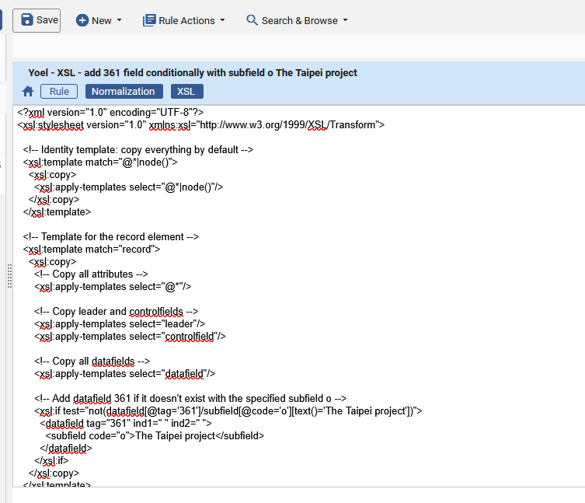
Globally updating records for Physical Holdings Records Retention
Here is the rule in Alma

Slide 40
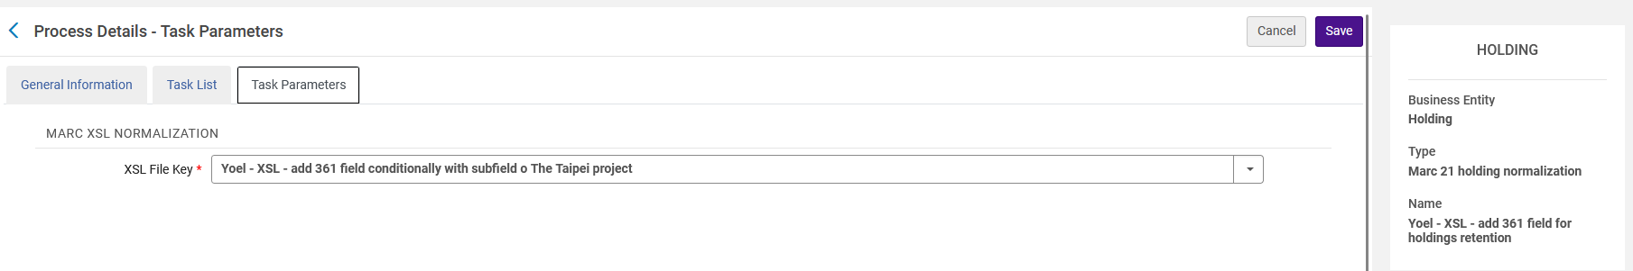
Globally updating records for Physical Holdings Records Retention
The normalization rule "Yoel - XSL - add 361 field conditionally with subfield o The Taipei project" has been added to a Holdings normalization process called "Yoel - XSL - add 361 field for holdings retention"
This normalization process was added via "Configuration > Resources > Cataloging > Metadata Configuration > MARC21 Holding > Normalization Processes > Add Process"

Slide 41

Globally updating records for Physical Holdings Records Retention
We have a set of bibliographic records named "Records to add 361 subfield o The Taipei project" which we would like to update:

Slide 42
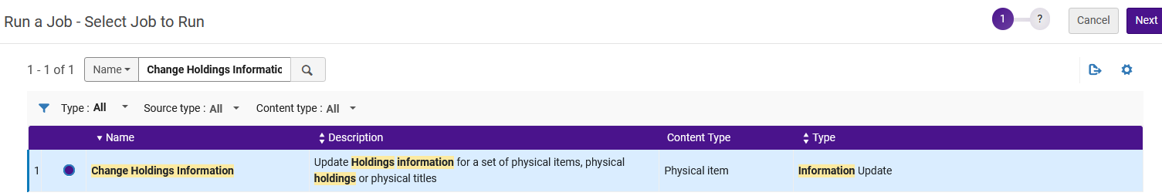
Globally updating records for Physical Holdings Records Retention
Via "Admin > Manage Jobs and Sets > Run a job" we run the job "Change Holdings Information"

Slide 43
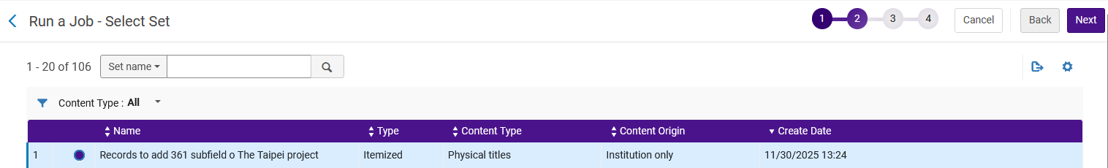
Globally updating records for Physical Holdings Records Retention
We choose the set "Records to add 361 subfield o The Taipei project"

Slide 44
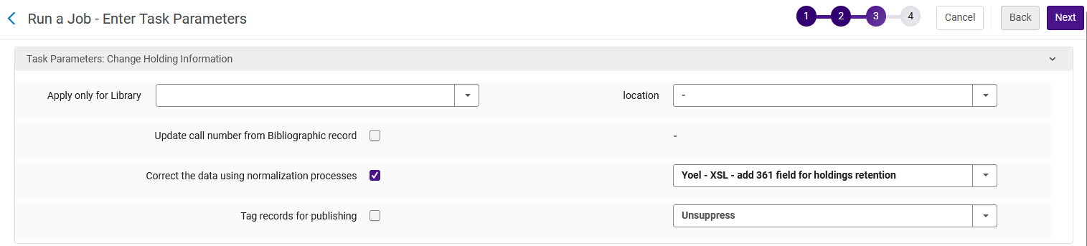
Globally updating records for Physical Holdings Records Retention
We check the box "Correct the data using normalization processes" and choose the normalization process we made for Holdings Records called "Yoel - XSL - add 361 field for holdings retention"

Slide 45
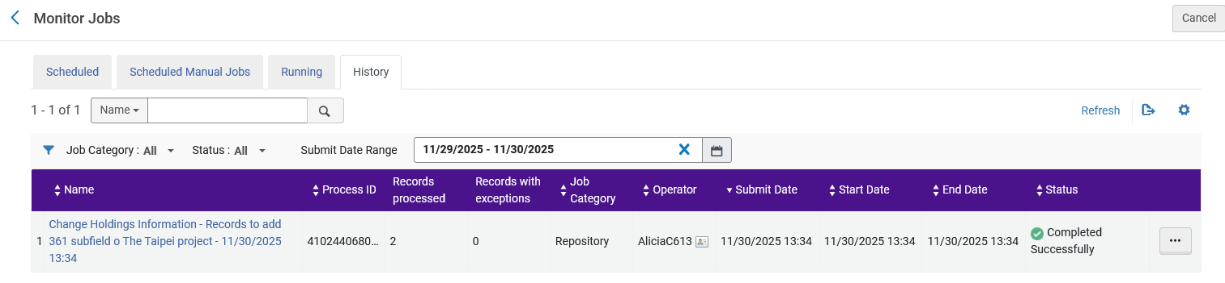
Globally updating records for Physical Holdings Records Retention
The job runs and successfully completes and (as we see on the next slide) the records get updated.

Slide 46
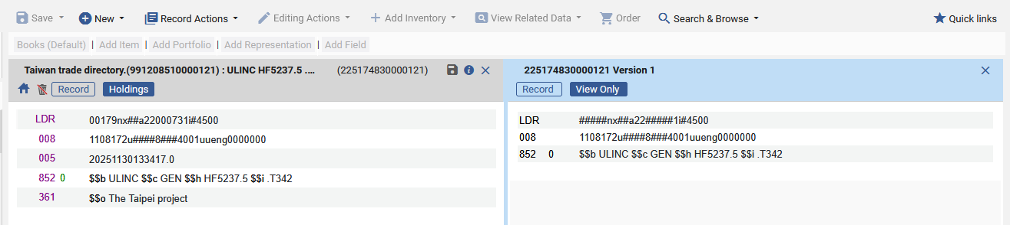
Globally updating records for Physical Holdings Records Retention
Here we view one of the holdings records from the set and via "View Versions" in the metadata editor we see that the previous version did not have a 361 field and now there is a 361 field with the specific subfield o, and the holdings record is committed to retain".
Previous Version
Current Version
Holdings Record is committed to retain

Slide 47
Physical holdings retention and the PO Line

Slide 48
Physical holdings retention and the PO Line
PO Lines of Type "Physical – Subscription" which have a "Committed to Retain" Holdings Record will include a "Committed to Retain" icon in the "Holdings for Order" section of the PO Line.
The "Committed to Retain" icon is in a column "Committed to retain" (title is hidden from view).
If the Holdings Record is Committed to Retain then the column will show the retention indication.
If the Holdings Record is not Committed to Retain then the column will be empty.

Slide 49
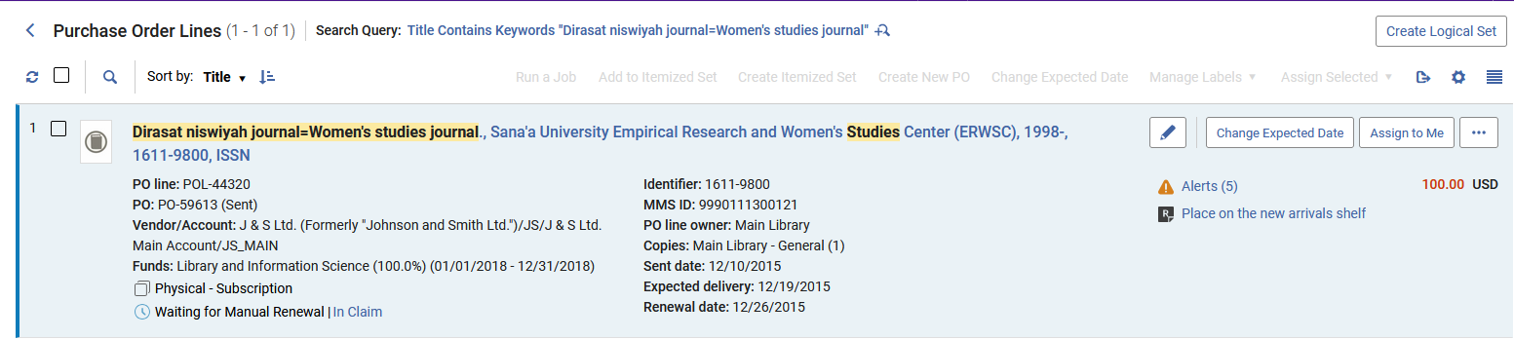
Physical holdings retention and the PO Line
Title "Dirasat niswiyah journal=Women's studies journal" is connected to PO Line POL-44320.
The PO Line Type is "Physical – Subscription"

Slide 50
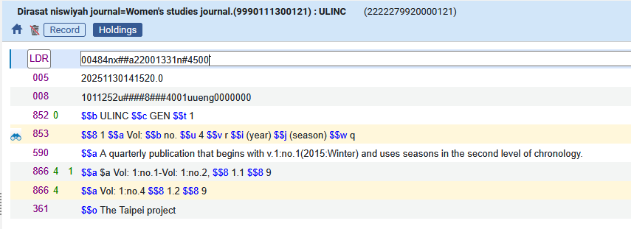
Physical holdings retention and the PO Line
The holdings record for title "Dirasat niswiyah journal=Women's studies journal" has a 361 field with subfield o "The Taipei project" and therefore is "Committed to retain"
The Holdings record is committed to retain

Slide 51
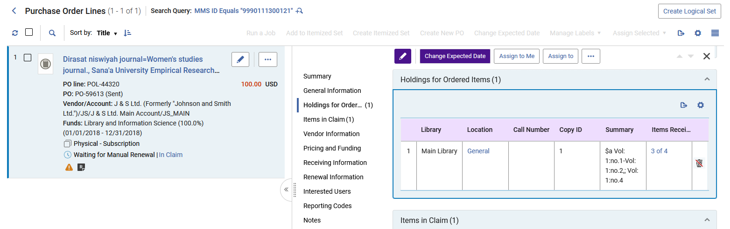
Physical holdings retention and the PO Line
When we view the "Holdings for Order" section of the PO Line we can see that the Holdings record is committed to retain.

Slide 52


Yoel Kortick
Yoel.Kortick@clarivate.com
About Clarivate
Clarivate is a leading global provider of transformative intelligence. We offer enriched data,
insights & analytics, workflow solutions and expert services in the areas of Academia & Government, Intellectual Property and Life Sciences & Healthcare. For more information, please visit clarivate.com.
© 2026 Clarivate. All rights reserved
Clarivate and its logo, as well as all other trademarks used herein are trademarks of their respective owners and used under license.

